Slide 1
What's new in ReportPortal 6?

Slide 2


Custom visual report
Code Mirror editor
Enhancements to: OLAP, SQL, Data Entry, and Dashboard

Slide 3
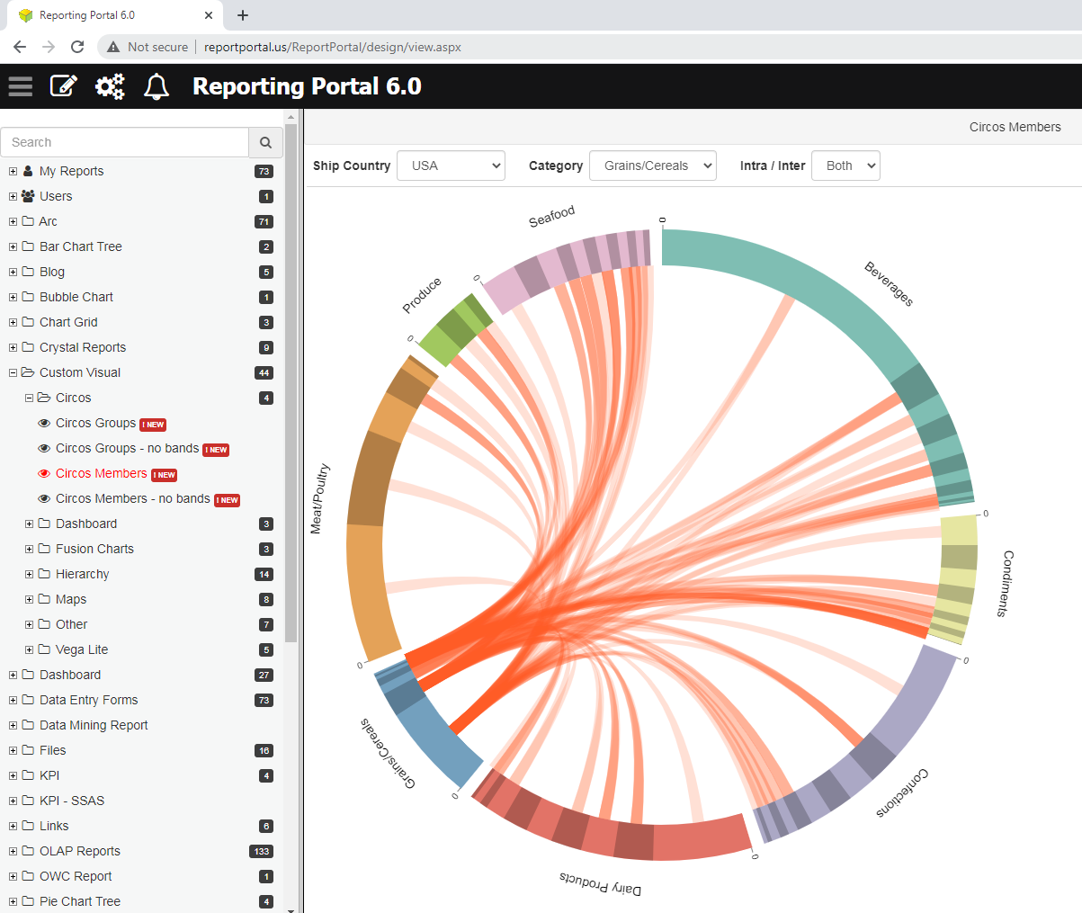
Custom visual - Circos

Slide 4
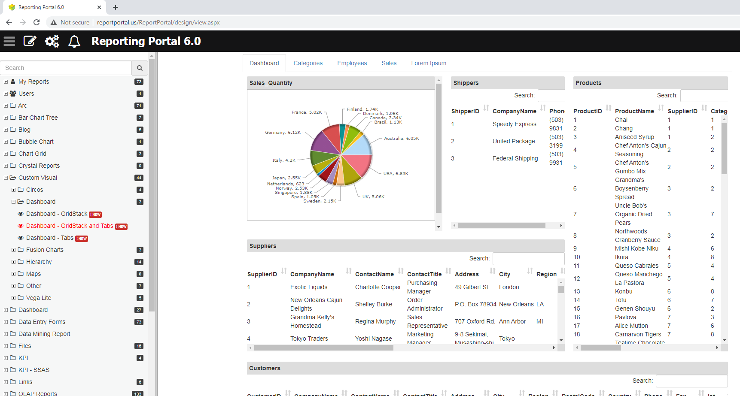
Custom visual - dashboards

Slide 5
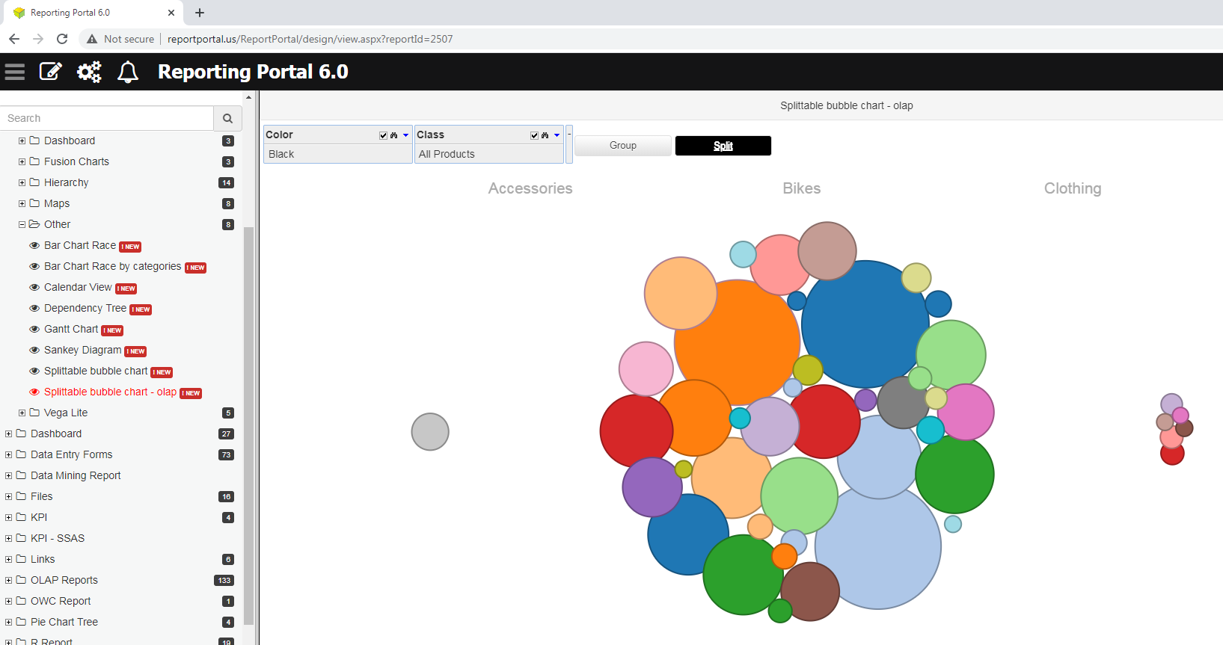
Custom visual - Splittable bubbles

Slide 6
Custom visual report
Ability to import and customize d3 data visualizations and link them to OLAP and relational data
HTML, CSS, JavaScript and SQL/MDX tabs
Support for filters (OLAP and SQL)
28 Templates. Provide the starting point and examples of how to create visuals
Ability to customize visuals via Preview tab. No JavaScript/HTML/CSS knowledge is required.
Support for multiple data sources (OLAP and SQL)
Support for Files (Excel, CSV, TSV and JSON).
JS and CSS files will be included on the page with script (.js) and link(.css) tags.
Upload image files (jpg, gif, png, bmp) can be used as images on the page.
Other file types such as .pdf, Office (.docx, pptx, .accdb) can be inserted as links to download the files.
Reuse code using Parent report feature

Slide 7
Data Entry
Hide-When feature for Fields, Panels, Children, Many, Tabs and Actions.
Advanced Panels features. Fields can be grouped under Panels. Panels can be grouped under Tabs. Tabs can be grouped under Parent Tabs.
Advanced Search features
Advanced File Upload features
JavaScript tab
Data Grid insert
Connect to view or add new table
Link Actions
Field formatting
A lot more…

Slide 8
SQL Report
Exporting: ODC, VBS, Large CSV Export, Excel - auto Filter
Filter: New Filter Types: Hidden, Text Area and HTML, Checkbox dropdown with search box, Radio Buttons - show as buttons
New Options: Search within each column, show sum, currency format
SQL Builder: ERD related tables and Group by function: Sum, Max, Min Count
Shortcut key: Control-s to save report in design mode. Click to see SQL in view mode
Alt-Click to see SQL in view mode
Multi-Result tabs option
Search within each column

Slide 9
Dashboard
Improved Tab look
Auto resize to 100% of the page
Save PDF options settings
Ability to select report snapshots
Support for dual (2007/2003) Excel export
Ability to add report snapshots

Slide 10
OLAP
Export: Excel Pivot table, ODF (Office Data File) and VBS to Excel
Chart: resize and close chart and legend, Custom X, Y Labels
Filter: Filter option (Play, Next Previous Buttons, With 100%, Parent and Speed), New Date calculations, filter with a named-Set
Paging: Improved performance, Page number is dropdown
Add Calculated Member > KPI Wizard > Progress Bar
Field List: support for Nested folders for Measures
MDX > XML is changed to JSON

Slide 11
ROLAP
- New options: Show Row empty items, Show Column empty items and Show Filter empty items
- SQL Builder: Ability to see tables related via foreign key constraint
Query Builder: Ability to resize Panels
- New Option: Filter Page Size
- Copy Dimension
- Options > Non Empty > Filter Type (LEFT, RIGHT, INNER, FULL OUTER)
- VBS Export Type

Slide 12
SQL View
Drag and drop and enhanced
Sorting
Rename columns
Drill down filters
Expand to Tab and Expand to Dialog options
Selecting group selects the column

Slide 13
For more information please visit ReportPortal Build History log:
http://www.reportportal.com/forum/forum.asp?FORUM_ID=7

