Slide 1
What's new in ReportPortal 5?

Slide 2
IE 10, 11 and Edge support
R Report
Google Maps

Slide 3
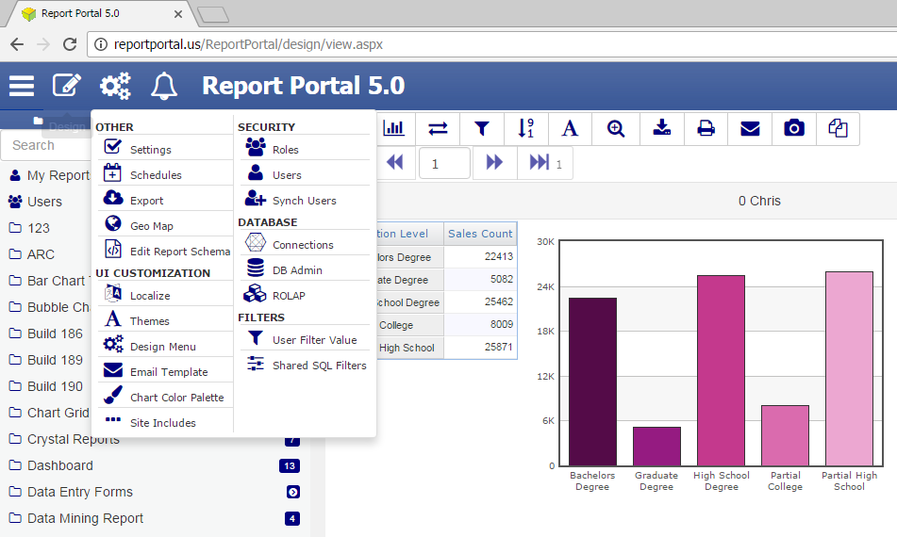
Modern looking UI

Slide 4
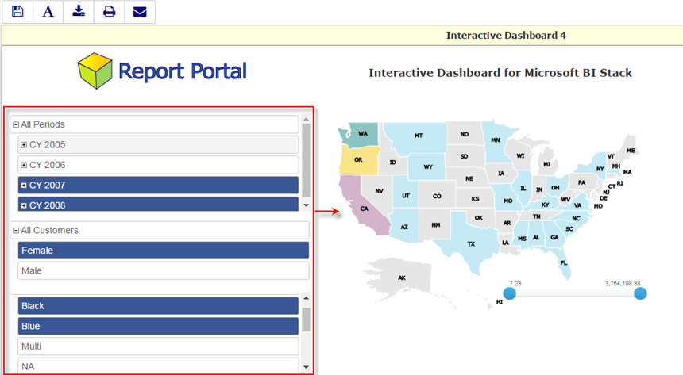
Dashboard: embedded filters

Slide 5
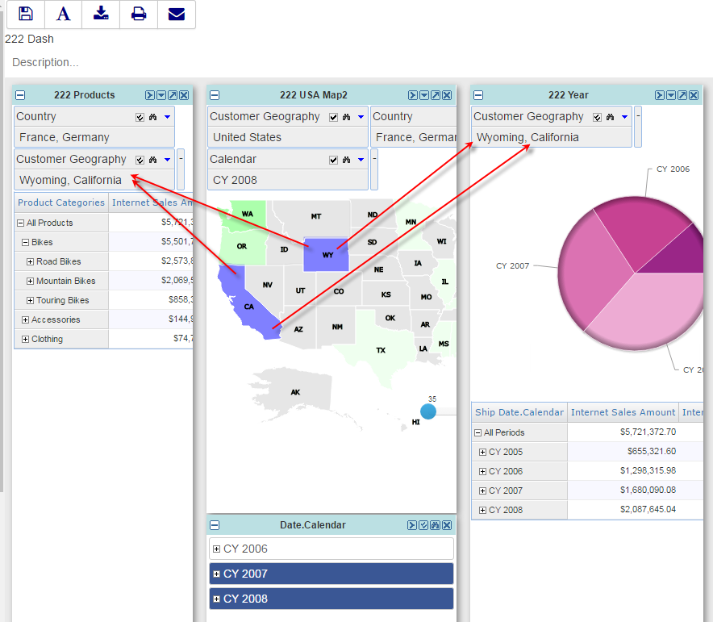
Dashboard: interactive support between visuals

Slide 6
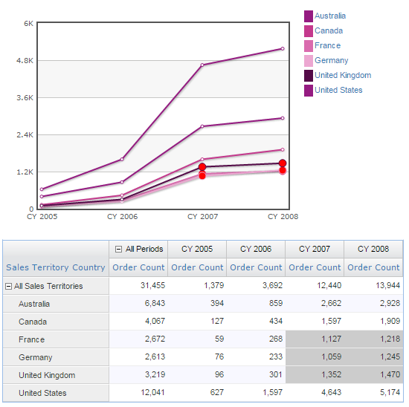
Chart elements highlighting
Chart and the grid are linked so that when some a cell is selected the corresponding chart elements is highlighted.
Similarly, when chart elements are selected corresponding cells are highlighted.

Slide 7
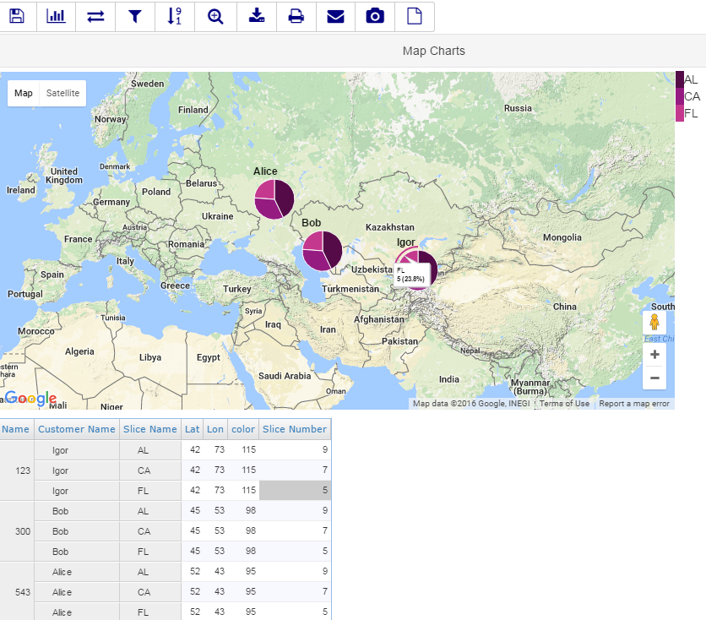
Google Maps

Slide 8
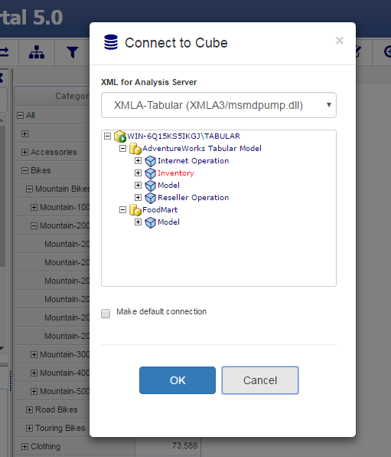
Tabular Model support
Connect to SSAS 2012 Tabular Model just like to a cube
The connection is made via XMLA

Slide 9
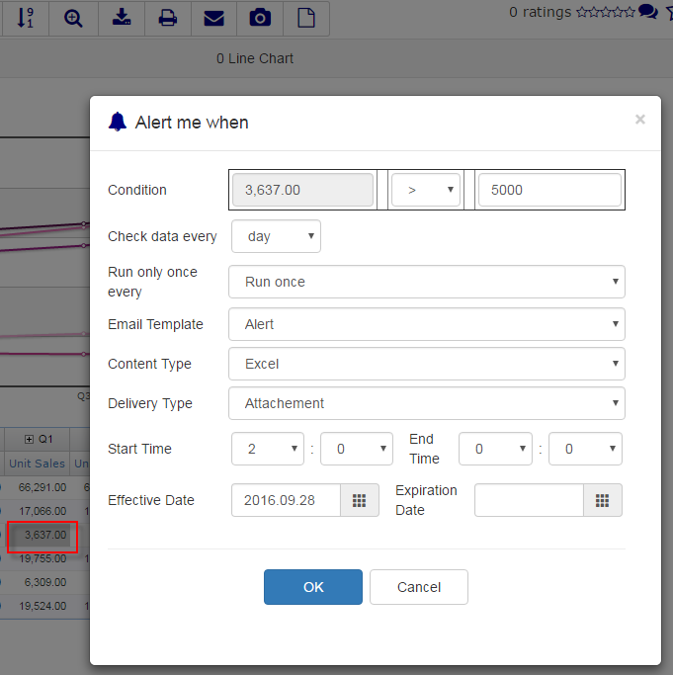
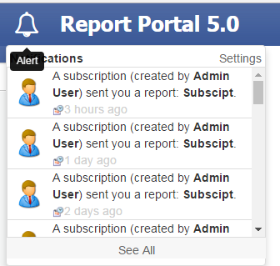
Alerts

Slide 10
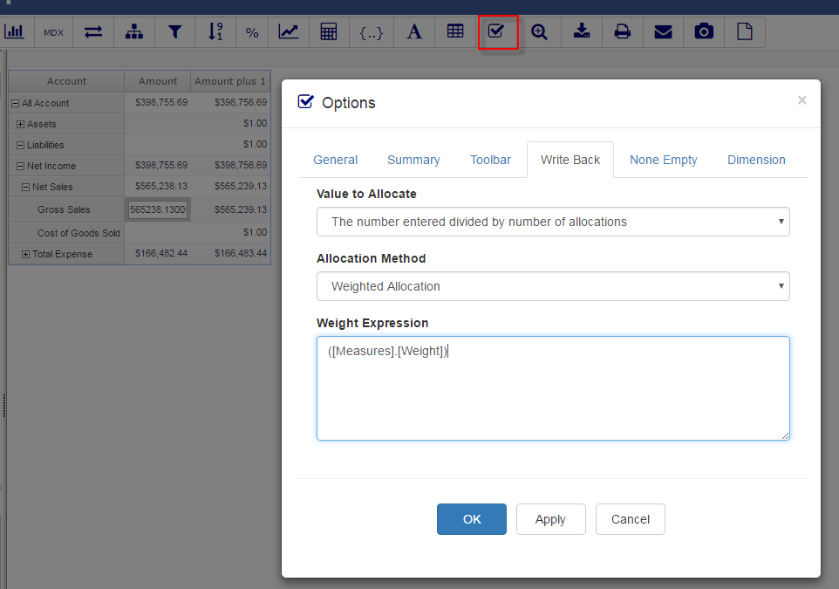
OLAP Report: advanced write-back options

Slide 11
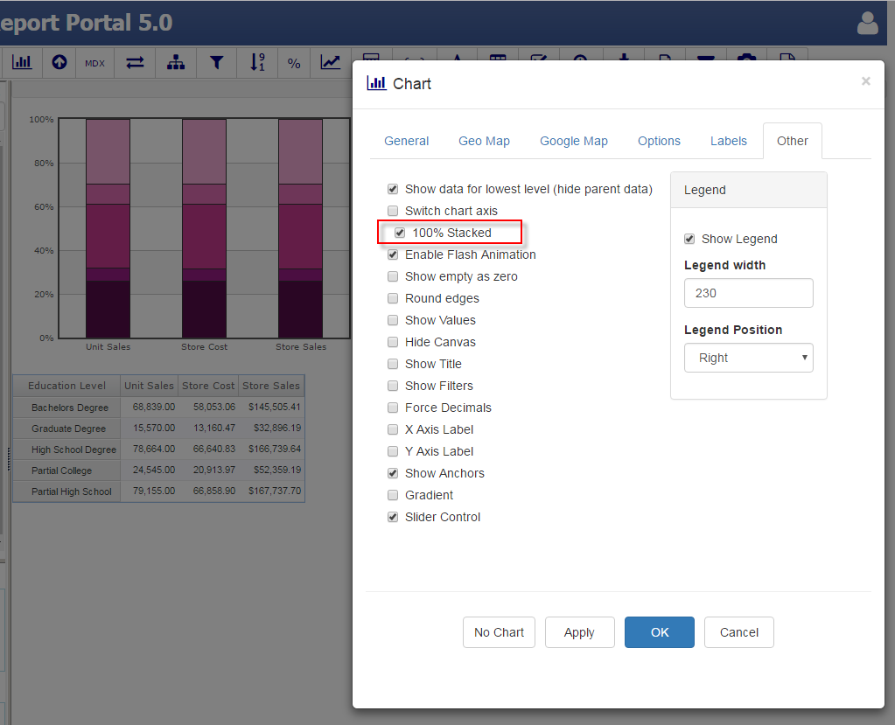
New chart options: 100% Stacked

Slide 12
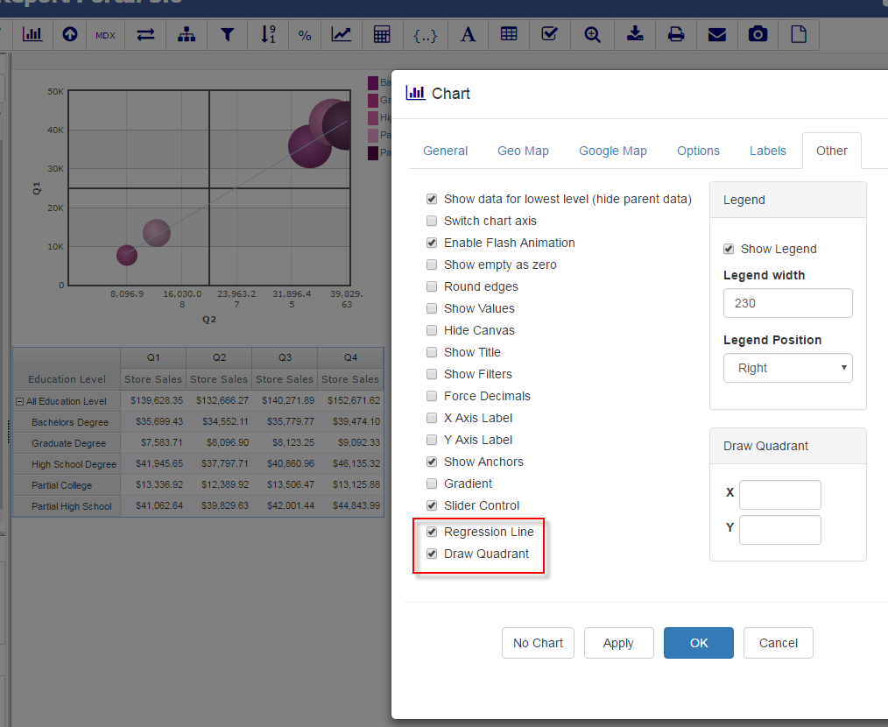
New chart options: Regression Line and Draw Quadrant

Slide 13
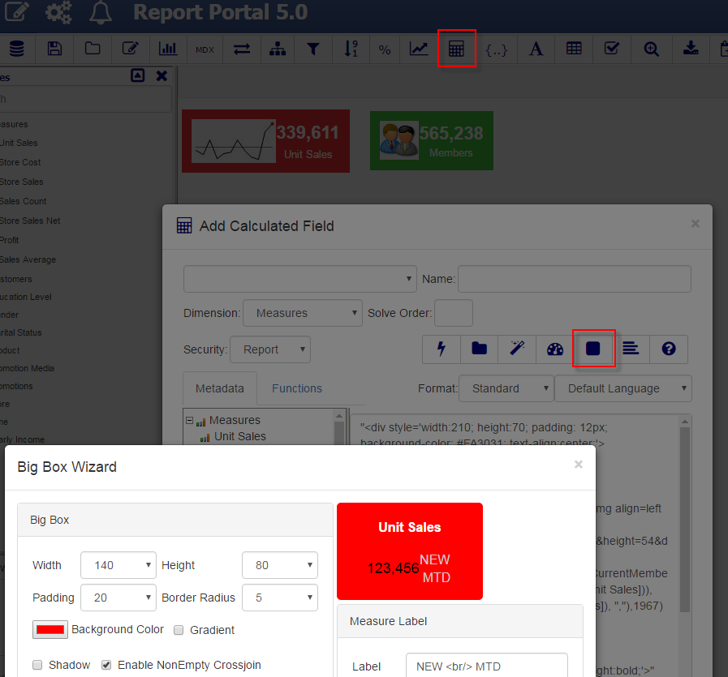
OLAP Report: Big Box Wizard

Slide 14
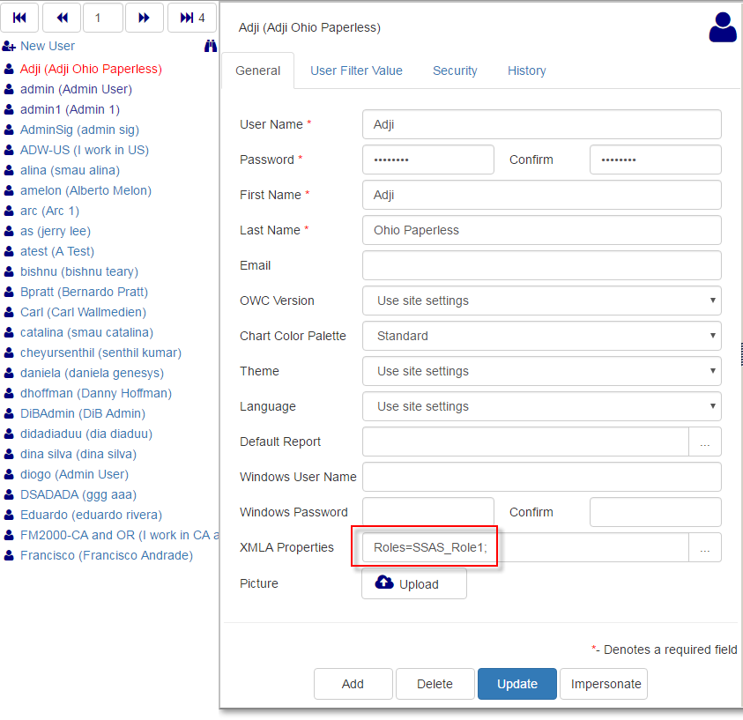
XMLA Properties field that can be used for custom SSAS security

Slide 15
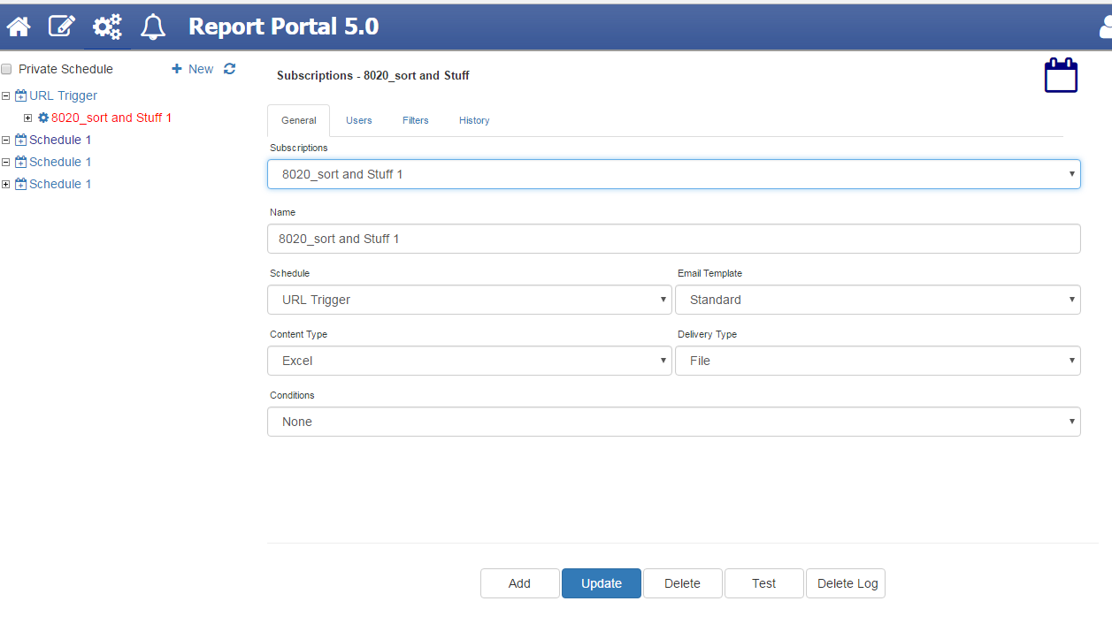
Scheduler
Support for new report types: Crystal, Link, R Report, ROLAP Report, SSRS File and Dashboards
New content type: CSV
Test button to run the subscription at any time

Slide 16
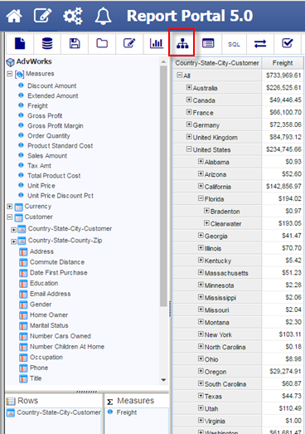
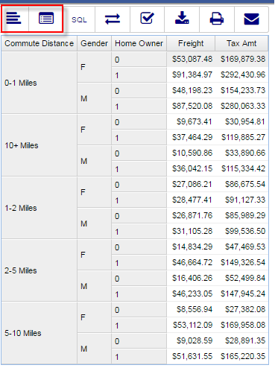
ROLAP Report: Expand and Expand-All mode

Slide 17
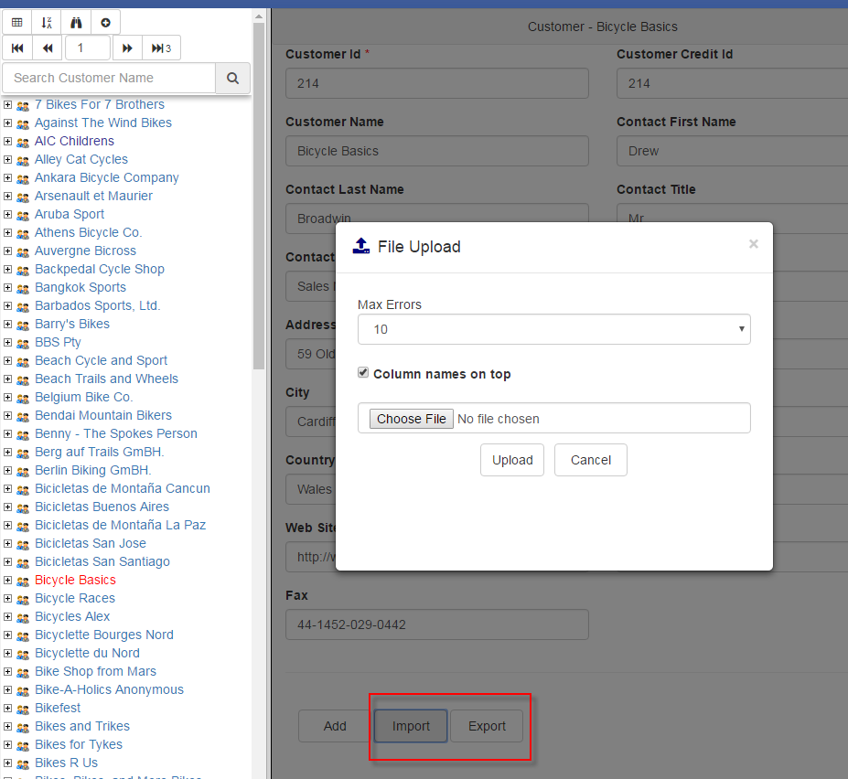
Data Entry: Export and Import files

Slide 18
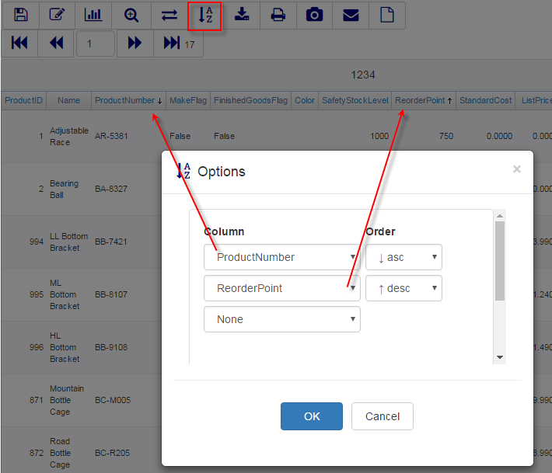
SQL Report: advanced sorting

Slide 19
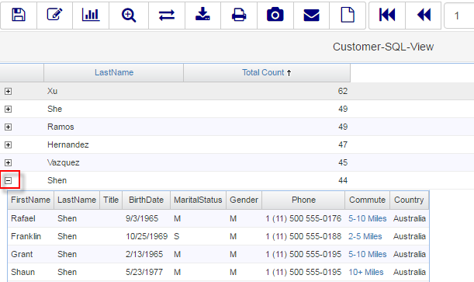
SQL View Report: Expand and Drilldown

Slide 20
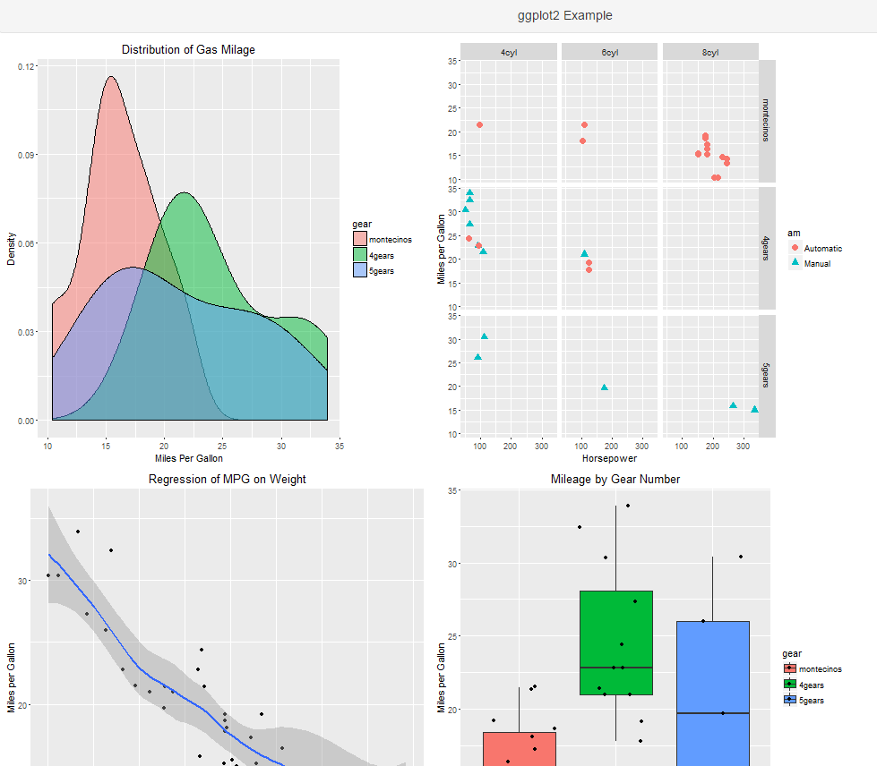
R Report
Importing of files and SQL data
Exporting of text, HTML, PDF and Excel
Snapshots
Scheduling
Filters

Slide 21
For more information please visit ReportPortal Build History log: http://www.reportportal.com/forum/forum.asp?FORUM_ID=7

