Slide 1
What's new in ReportPortal 4?

Slide 2



IE 10, Chrome, Firefox and Safari support
Excel 2007 and up support
.NET 4.0 support

Slide 3
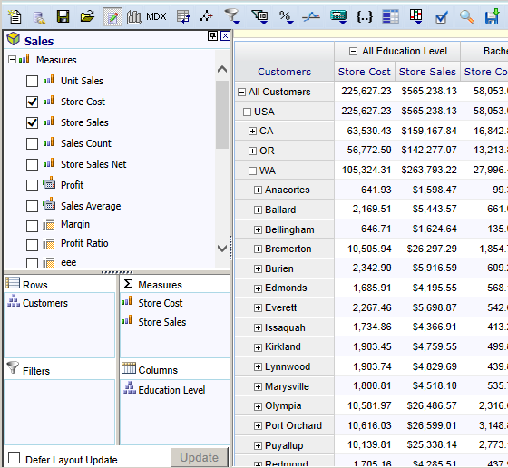
OLAP and ROLAP reports have new drag and drop Excel 2007 style interface

Slide 4
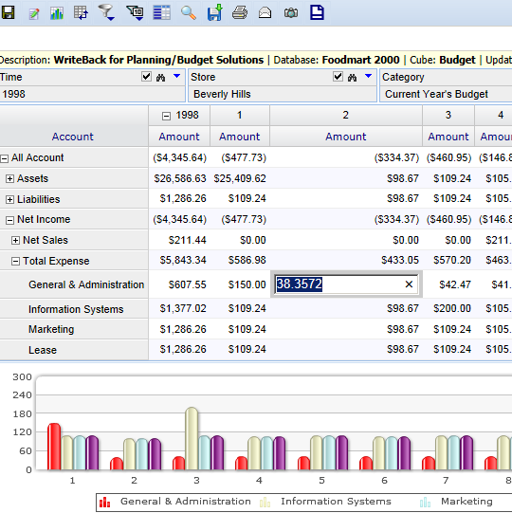
Ability to enter a value directly into a cell when the cube is Write-back enabled

Slide 5
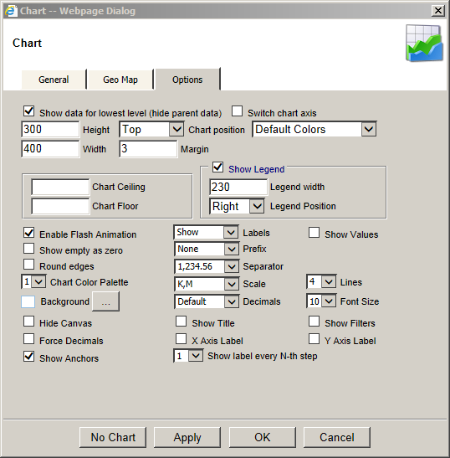
Improved charts
Charts no longer need Flash installed
Advanced charting options

Slide 6
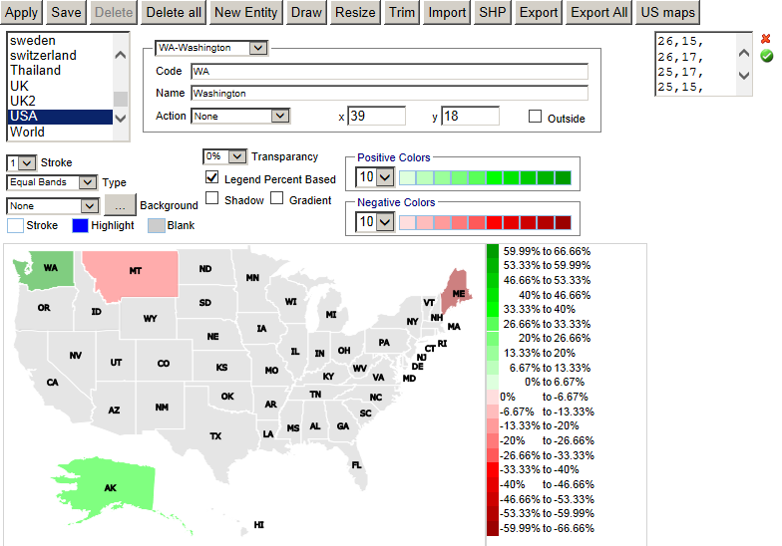
MAP SDK is moved to Admin > Geo Map.
Maps can be be generated and imported using the browser

Slide 7
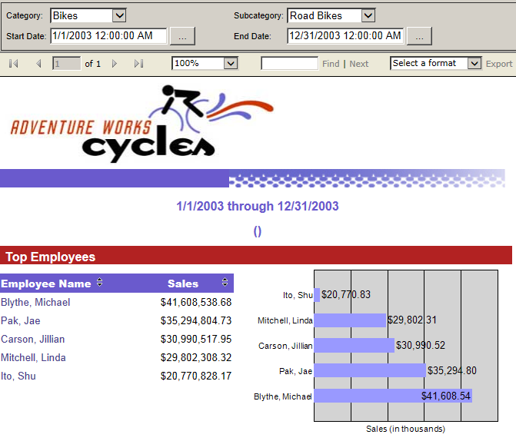
New SSRS File report type lets you serve SSRS reports to the web users without need to expose SQL Server to the web

Slide 8
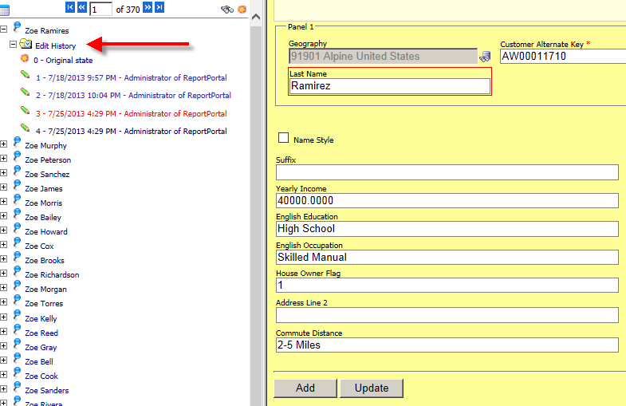
Data Entry can save record history and roll back records changes

Slide 9
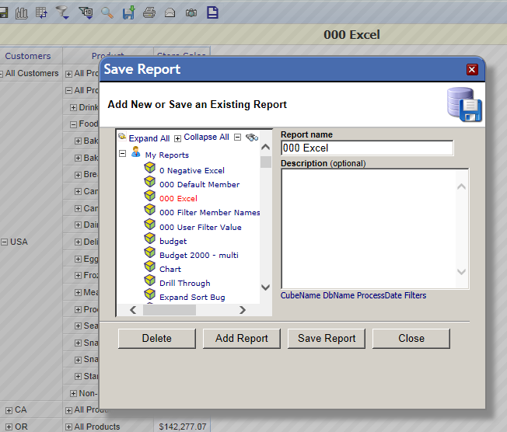
Show iframe dialogs option to show dialogs inside of the browser

